Slide 1





GPU Optimized Math Routines in the Stan Math Library
Rok Češnovar, Davor Sluga, Jure Demšar, Steve Bronder, Erik Štrumbelj

Slide 2
MAIN GOAL
Faster model inference for Stan users ...
... in a seamless and cost-effective way.

Slide 3
TALK OUTLINE
Motivation: GP regression.
Parallelization & GPUs.
Stan + OpenCL.
Paralellizing the Cholesky decomposition.
Challenges & Roadmap.

Slide 4
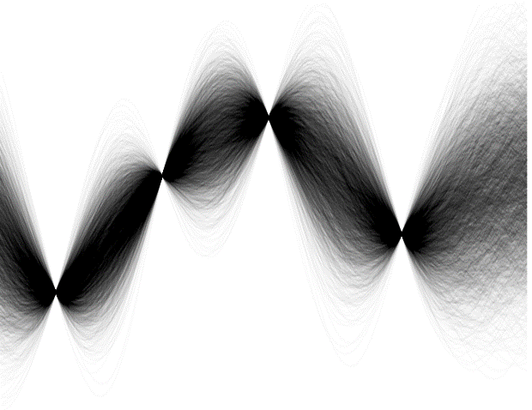
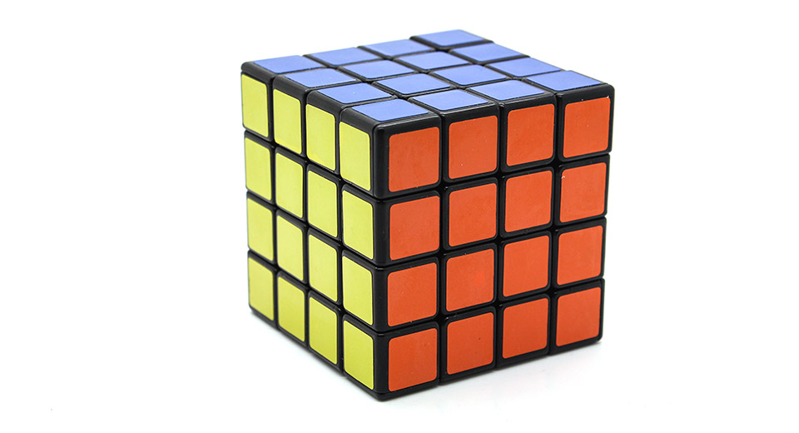
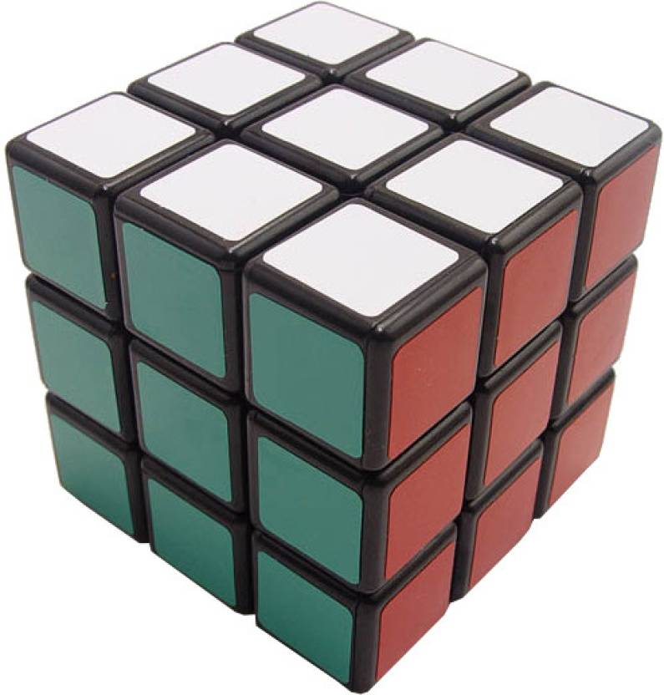
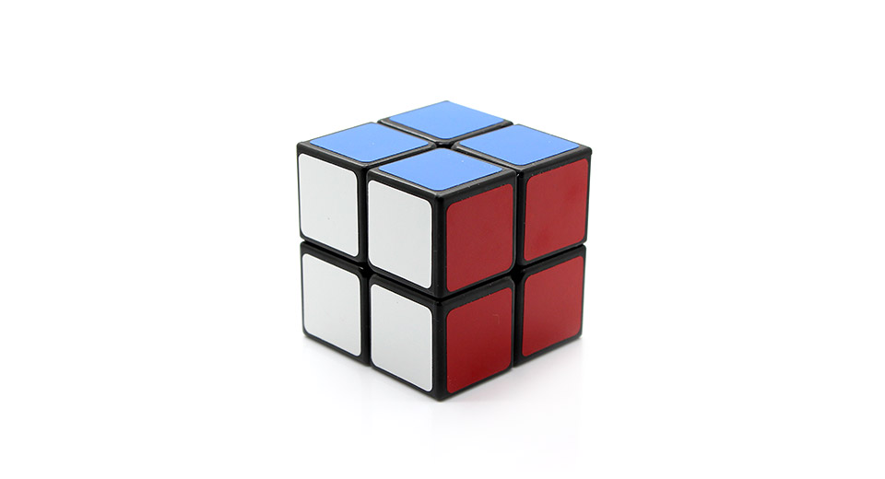
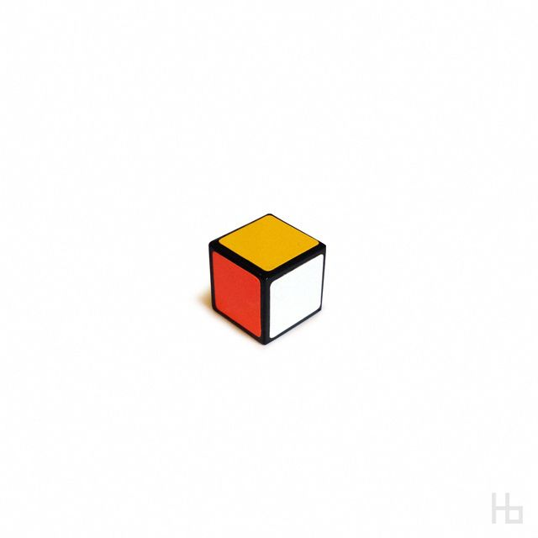
GP REGRESSION
Gaussian Processes are very useful but ...
... computation scales unfavorably - O(n³).
What can we do?
Approximate inference.
Run the computation on a better CPU.
Run the computation in parallel.

Slide 5
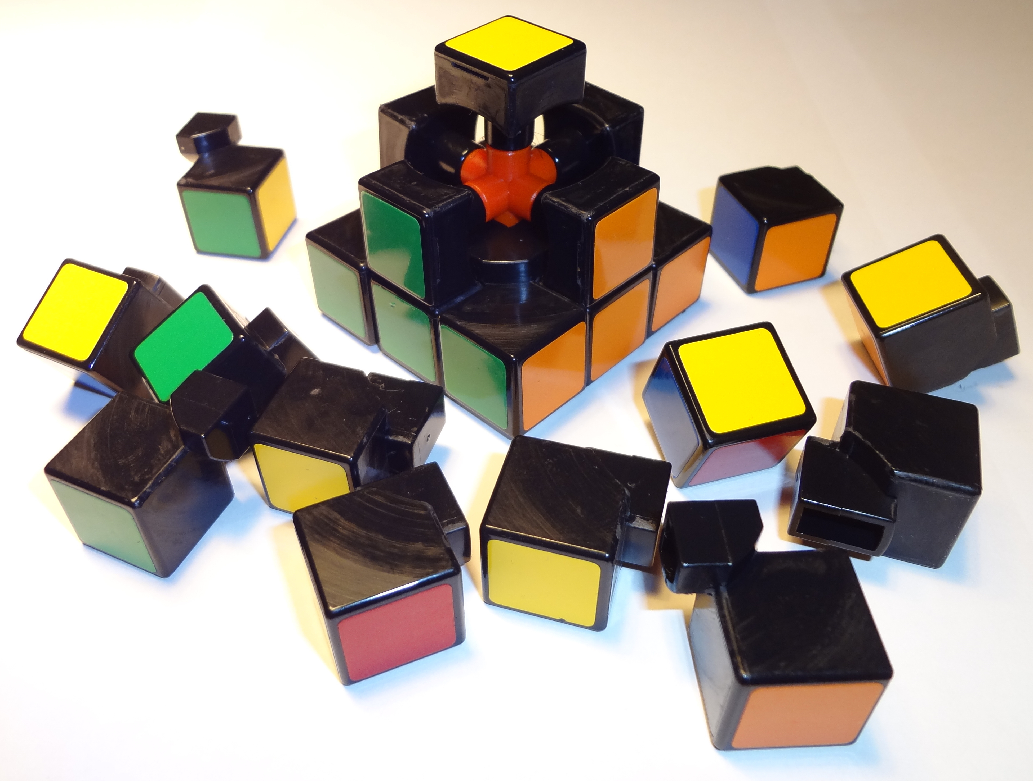
PARALLELIZATION 101
Break the problem up into smaller pieces and compute them in parallel.
The pieces must be:
Small enough to keep all individual processing units busy most of the time.
Large enough to avoid too much overhead with breaking them up and putting them back together.
Maximum speedup limited by the parts we can‘t parallelize (thanks, Amdahl!).

Slide 6
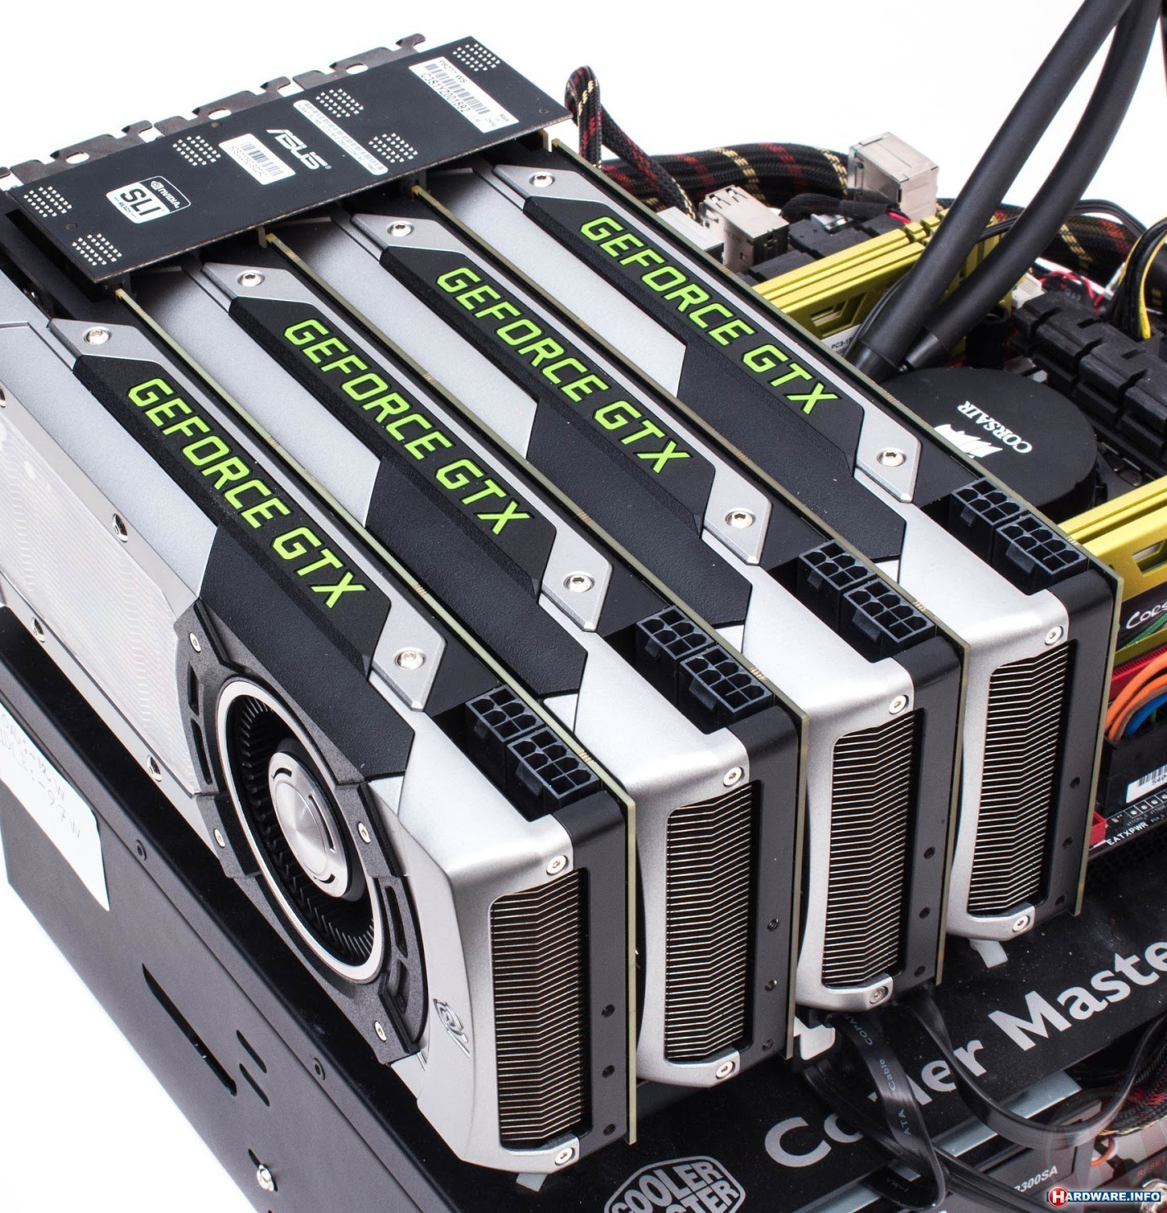
WHY GPUs?
Properties of GPUs:
Everyone has a GPU.
Massive parallelism – thousands of „cores“ (best performance/cost ratio).
Optimized for vector and matrix problems.
Faster data transfers compared to clusters.
Energy-efficient.

Slide 7

Stan
+ OpenCL

Slide 8
OpenCL
Parallel framework CPUs, GPUs, DSPs, FPGAs,…
Special functions (kernels) are executed by N threads on target devices.
APIs for C, C++, Python, Julia…
Open standard maintained by the Khronos Group.
Typical example:
Copy input data to the OpenCL device,
parallel execution of special functions on the OpenCL device and
copy the results back to the host.

Slide 9
What‘s an
OpenCL Context?
It‘s like a scheduler:
Manages the devices, queues, platforms, memory alloc, etc.
Devices: GPUs and CPUs.
Platforms: Implementations of OpenCL (Khronos’s OpenCL vs. Intel’s OpenCL).
The context has a ‘program’ object that manages kernels for devices and platforms.

Slide 10
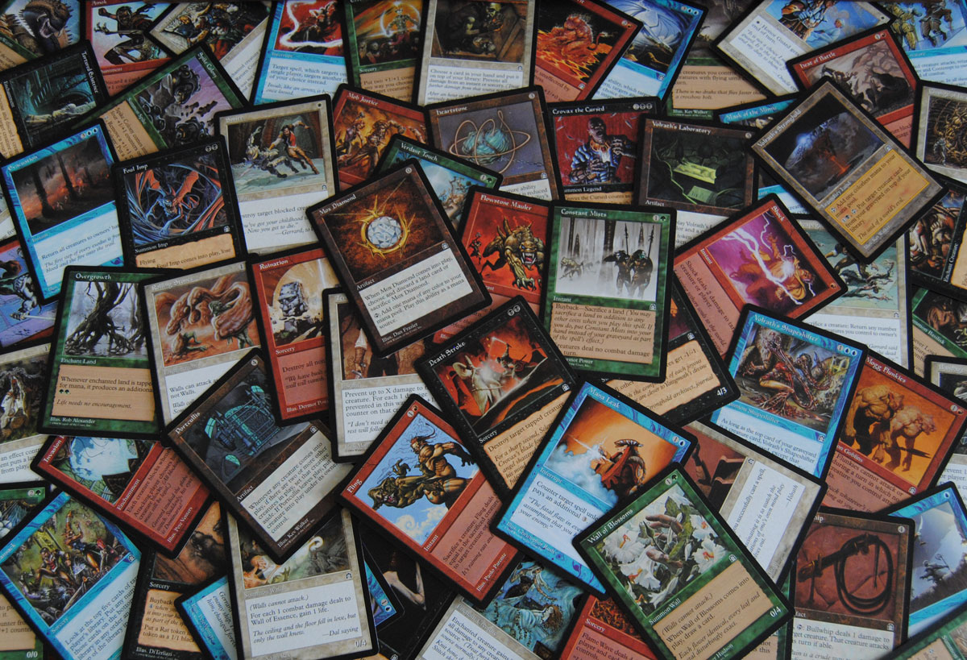
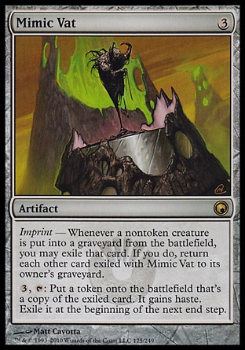
OpenCL Context
We only want one context to exist so it’s stored as a singleton.
Access the context through an adapter API.
IE: In the adapter class opencl_context
// Return the stan program’s context
inline cl::Context& context() { return opencl_context_base::getInstance().context_; }
...
// developers access
auto ctx = opencl_context.context()

Slide 11
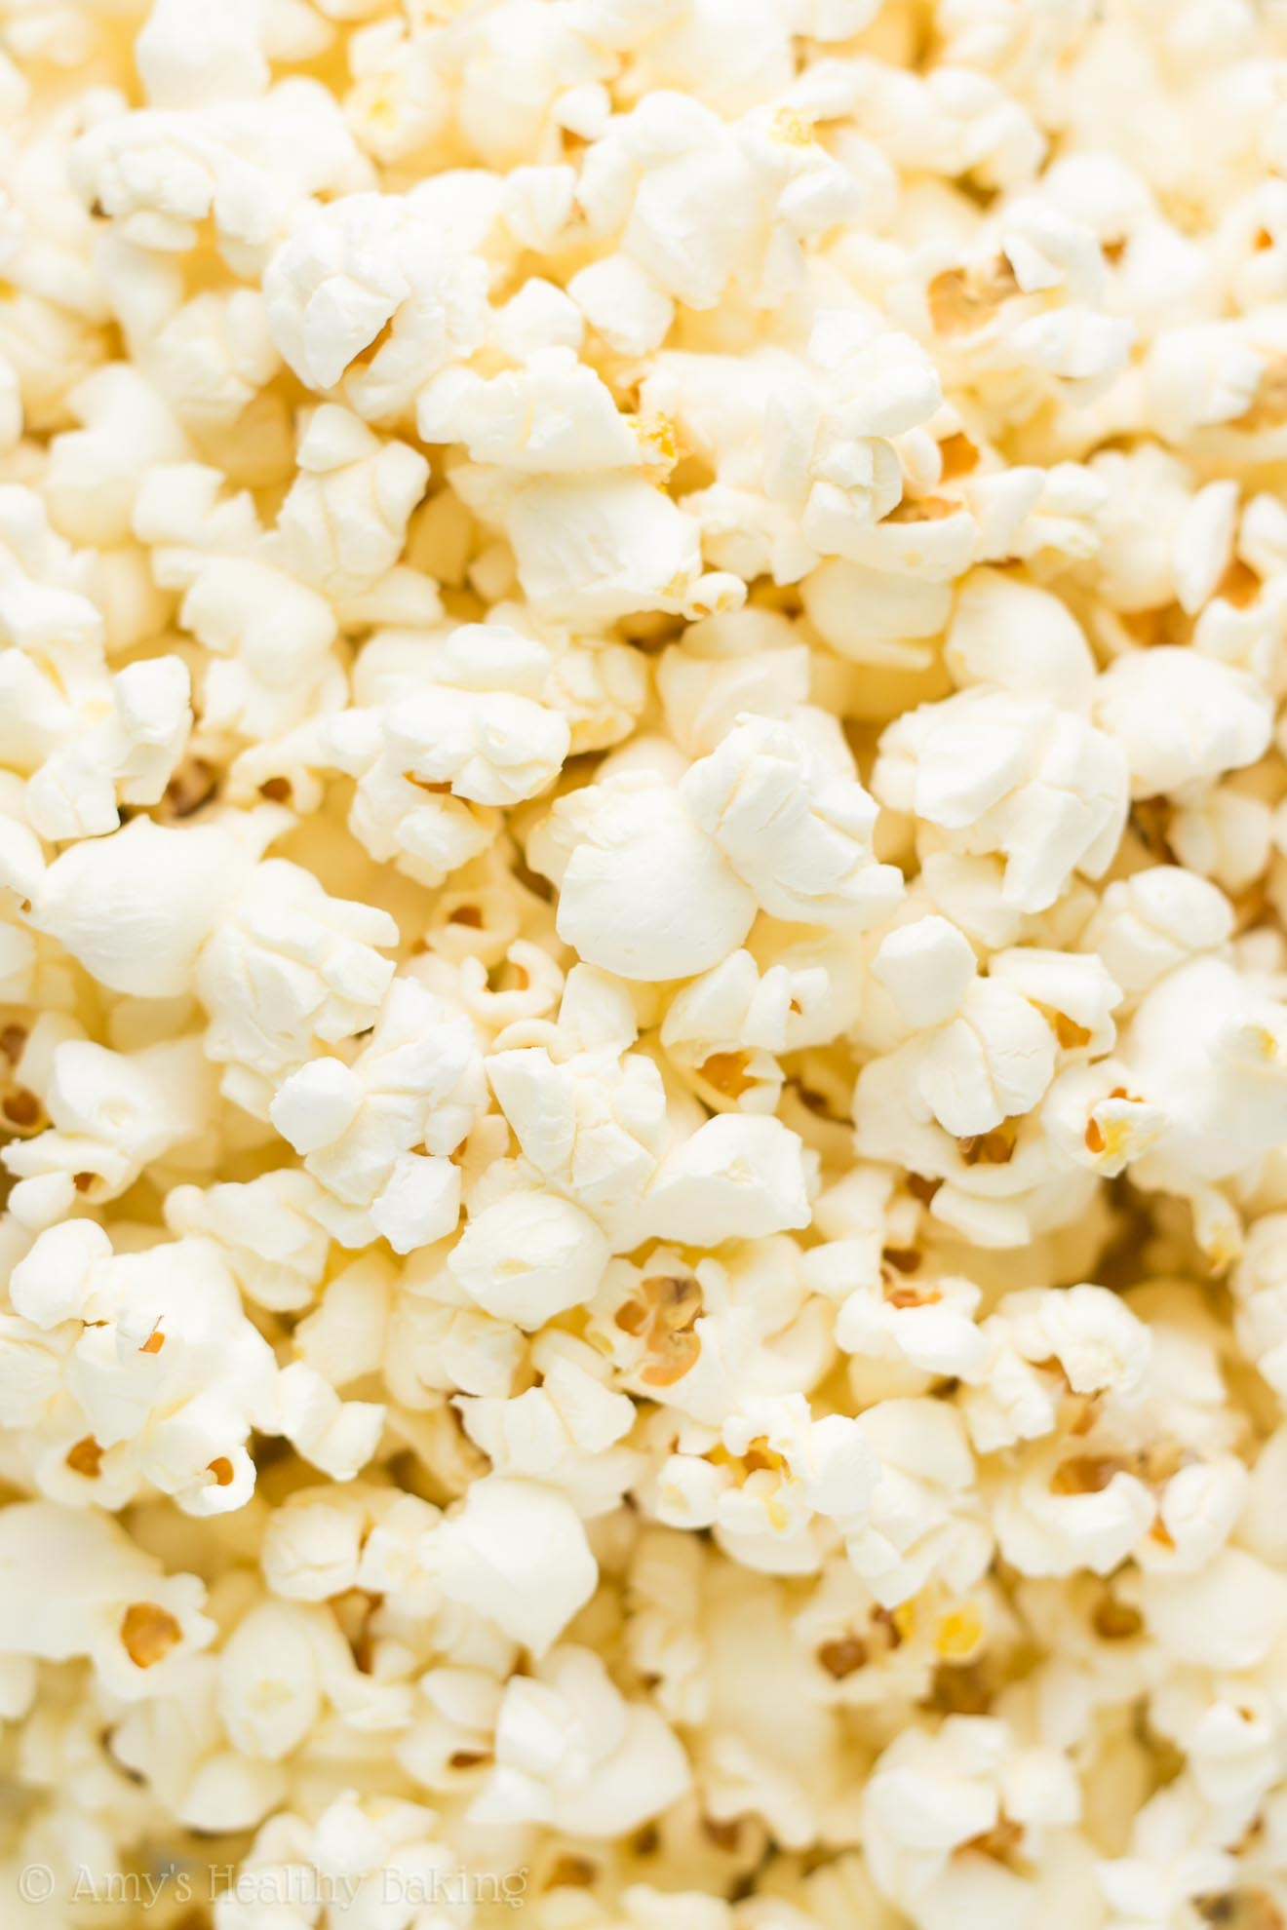
Making Kernels
We want to make it simple for users to add and use kernels.
Reworked design with Sean Talts and Rok.
Making a kernel:
A kernel that only needs to set the global work size.
Name of kernel
const global_range_kernel<cl::Buffer, cl::Buffer, int, int> copy("copy", copy_kernel_code);
Argument Types kernel accepts
String literal holding the kernel code

Slide 12
Accessing Matrices on the Device
Developers move Stan matrices over to matrix_cl matrices:
matrix_d d1
matrix_cl d1_cl(d1)
Users operate on these like Stan matrices:
matrix_cl d3_cl = d1_cl + d2_cl
matrix_cl d4_cl = cholesky_decompose(d1_cl)

Slide 13
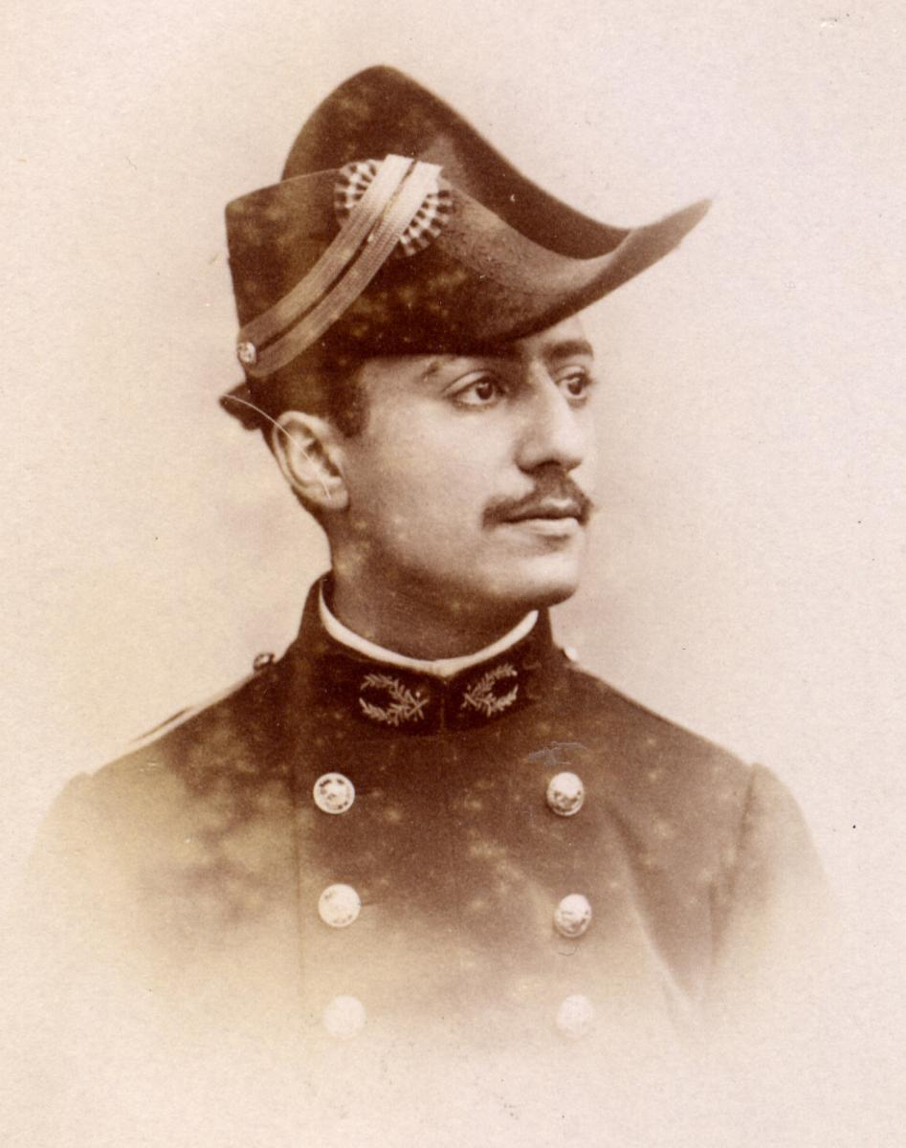
First GPU-optimization available to Stan users:
Cholesky Decomposition

Slide 14
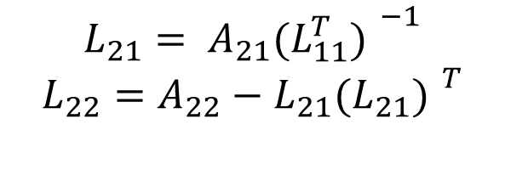
A11
L11
A21
A22
L21
L22
Cholesky
Decomposition
Our first bottleneck target in Stan.
Almost no naive parallelim in the basic algorithm.
No real speedup on the GPU.
Blocked-cholesky is computationally more complex, but GPUs are made for fast matrix multiplications.
$$L_{21}= A_{21}{(L_{11}^{T}) }^{−1}$$
$$L_{22}=A_{22}−L_{21}{(L_{21}) }^{T}$$

Slide 15
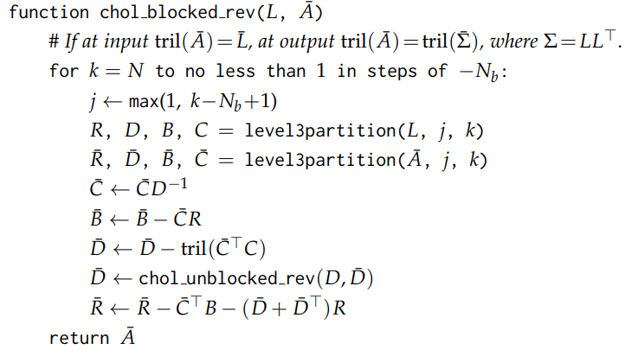
Derivative
of the Cholesky
Decomposition
GPU implementation of Murray (2016):
Eigen version already in Stan Math,
largest bottlenecks are matrix multiplication and lower triangular inverse.
As a consequence - GPU implementations of
matrix multiplication,
lower triangular inverse,
+, -, transpose, partition.

Slide 16
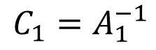
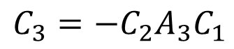
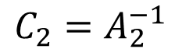
A1
C1
Lower triangular inverse
A3
A2
C3
C2
GPU Basic forward substiution algorithm not suitable for GPUs.
$$C_{1}=A_{1}^{−1}$$
$$C_{2}=A_{2}^{−1}$$
$$C_{3}=−C_{2}A_{3}C_{1}$$

Slide 17
Lower triangular inverse
1
1
1
1
1
1
1
1

Slide 18
Lower triangular inverse
1
1
2
1
1
1
1
2
1
1
1
1
2
1
1
1
1
2
1
1

Slide 19
Lower triangular inverse
1
1
2
1
1
3
1
1
2
1
1
1
1
2
1
1
3
1
1
2
1
1

Slide 20
Lower triangular inverse
1
1
2
1
1
3
1
1
2
1
1
4
1
1
2
1
1
3
1
1
2
1
1

Slide 21
RESULTS (simple 1D GP regression on N points)

Slide 22
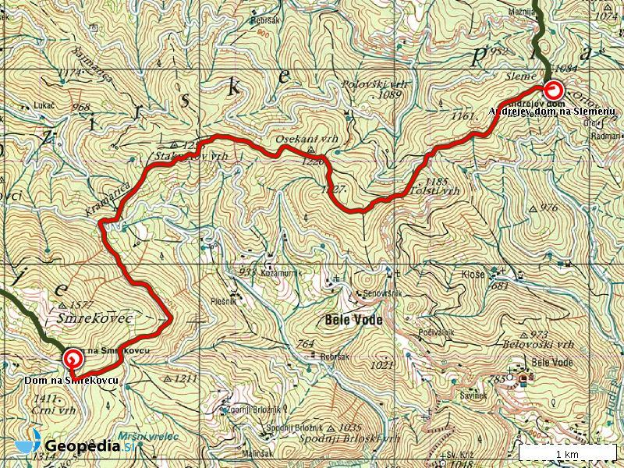
Challenges
& Roadmap

Slide 23
Issue: Data tranfers
Currently, speedups are limited by data transfers:
Copying data to the GPU costs us some time.
Most functions scale linearly and can‘t justify this cost for every call.
Even is such functions represent 10% of the computation, it drastically limits the maximum speedup.
Example:
cov_exp_quad(x1, magnitude_1, length_scale_1)
+ cov_exp_quad(x1, magnitude_2, length_scale_2)
+ gp_periodic_cov(x1, magnitude_3, length_scale_3_1, 7)
.* cov_exp_quad(x1, 1.0, length_scale_3_2)
+ gp_periodic_cov(x1, magnitude_4, length_scale_4_1, 365.25)
.* cov_exp_quad(x1, 1.0, length_scale_4_2)
+ gp_dot_prod_cov(I_s, magnitude_5_1)
+ gp_dot_prod_cov(I_ss, magnitude_5_2)
+ gp_dot_prod_cov(I_ws, magnitude_5_3)
+ diag_matrix(rep_vector(jitter, N2));`

Slide 24

Multiple Devices and
OOM Algorithms
OpenCL can run on CPUs and GPUs, so why not use both?
We know some problems are too small to send to the GPU, so use OpenCL on the CPU.
Needs a ‘smart’ load balancer that can look at a ‘job’ and decide where to send it.
Current algorithms are limited by GPU DRAM.

Slide 25
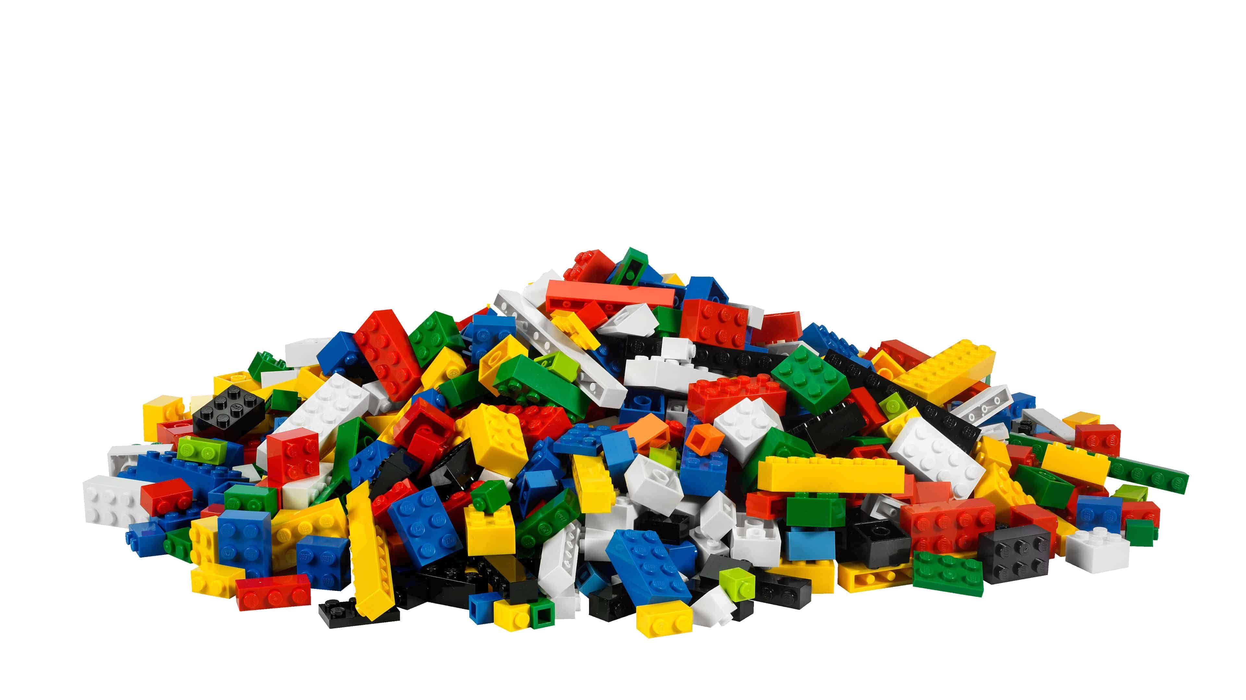
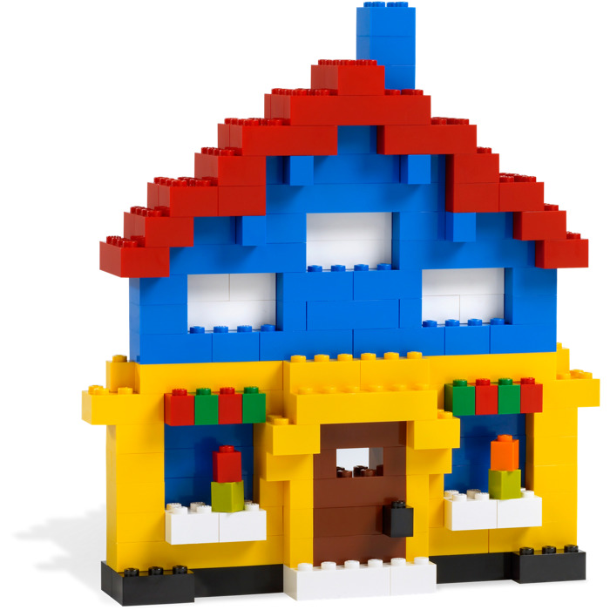
From single routines to
(almost) entire models
Idea: move the bulk of the log-posterior computation (including „hand-made“ gradients) to the GPU.
Promising results on some models (~100x speedup).
Currently in the works:
GLM (linear, logistic, Poisson, NB regression...). For example:
bernoulli_logit_glm_lpdf(y | X, beta, alpha);
Roadblock: Data transfers!

Slide 26

Conclusion
GPU support in Stan: Coming very soon!
First, inverting covariance matrices...
... other building-blocks will follow.
Reasonable expectation: 10-200x speedup
Prototype branch:
If you have any questions, comments, ideas... let us know! We‘re also accepting requests. ☺
https://github.com/bstatcomp/math/tree/stancon2018

